Slide 1

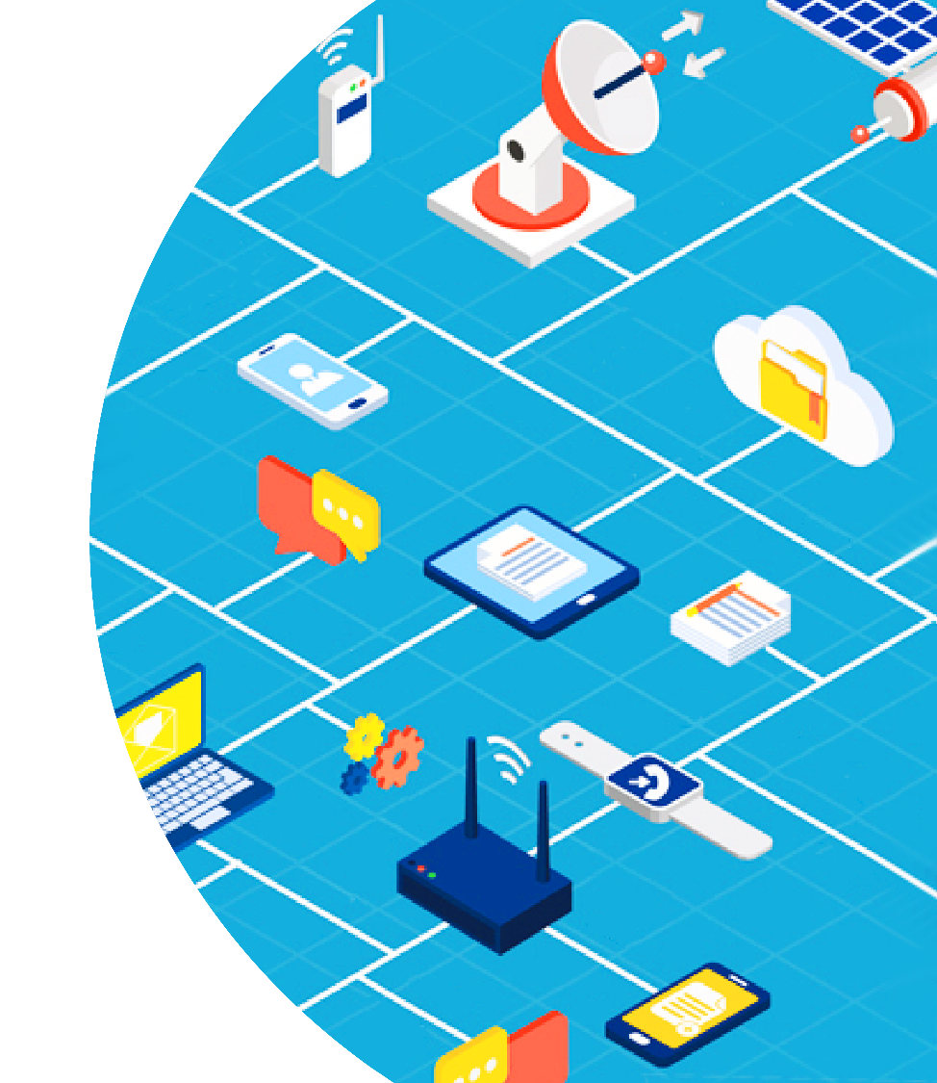

IoT
Introduction

Slide 2
Contents
Definition
IoT Applications
Typical IoT Solution Architecture
Device
Gateway
IoT Platform

Slide 3
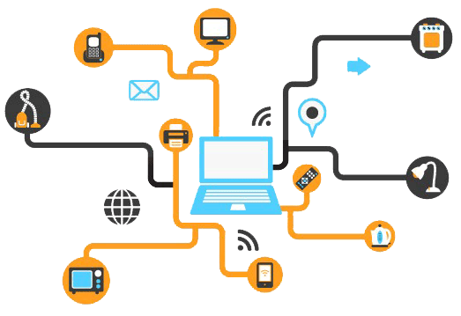
Definition
Set of technologies and use cases with no clear, single definition
Use of network-connected devices, embedded in physical environment
Improve existing process or enable a new scenario

Slide 4
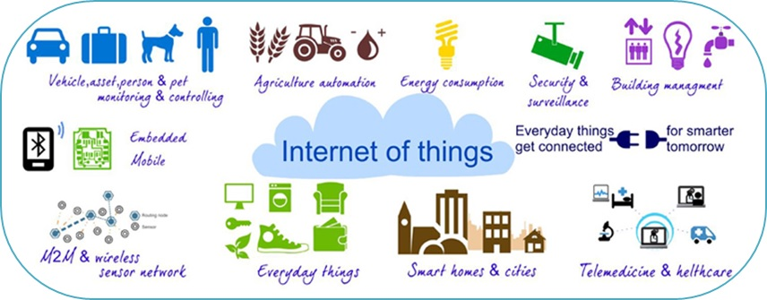
IoT Applications

Slide 5
Top Application Areas
Smart city
Energy and waste management
Public traffic and infrastructure management
Smart parking
…
Smart building and home automation
Healthcare
Patients surveillance (fall detection, health monitoring…)
Pollution management
Automotive
Transportation vehicles geo and status tracking
Self driving cars
Smart Retails
Asset tracking
Stock replenishment, Virtual reality, Wireless sensing and tracking

Slide 6
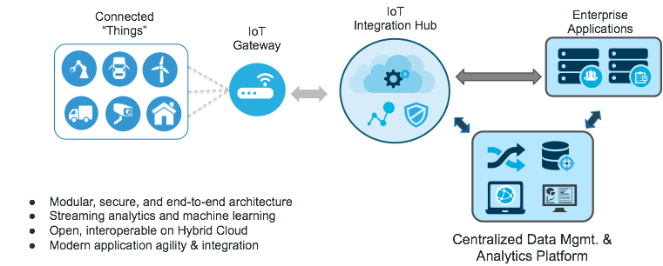
IoT Solution Architecture

Slide 7
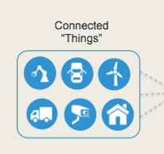
Connected Things (Devices)
Includes hardware and software
Directly or indirectly connected to the internet
Connect to network or communicate with each other
Interact with world through sensors (collect environmental data, called telemetry data) and actuators (control other things)
Example
Mobile
Vehicles
Cameras
Lab monitor equipment
Everyday things

Slide 8
Gateway
Bridge between IoT Platform and devices not directly connected to Internet due to:
Limited processing power or connectivity (wearables)
Limited energy (battery powered)
Should support various communication protocols
Process data on behalf of a group or cluster of devices before sending to IoT Platform

Slide 9
IoT Platform
Manage devices and data
Efficient, scalable (expand easily) and secured
Cloud based or on premise
Main components:
Device management
Message broker
Data processing
Data storage
Analytics
Visualization Application

Slide 10
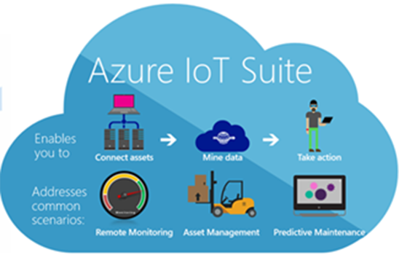


Popular IoT Platforms

Slide 11
Device Management
Device provisioning (registration, authentication and authorization)
Manage device metadata (ID, type, model, revision, manufacturer…)
Over the air (OTA) firmware update

Slide 12
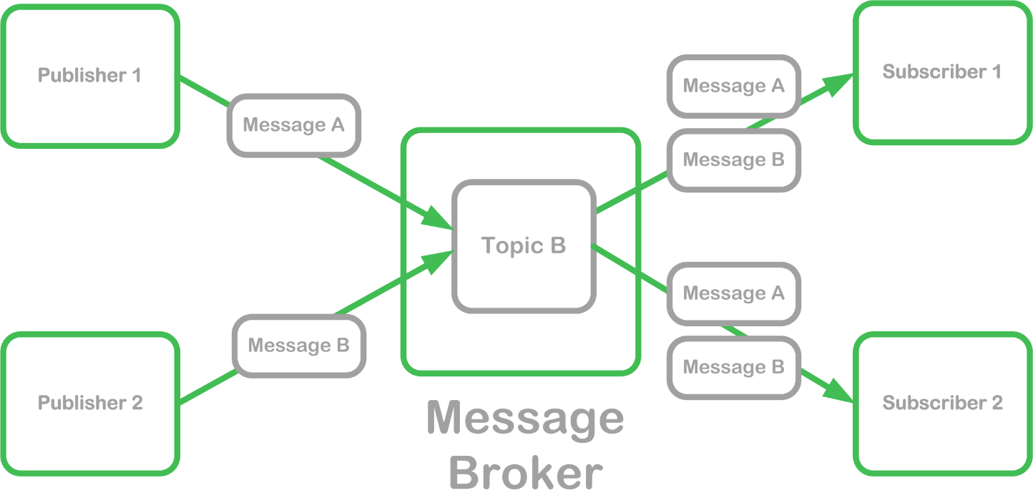
Message Broker
Receive message from multiple destination (publishers)
Determine correct destination and route to correct channel (subscriber)
PubSub pattern

Slide 13
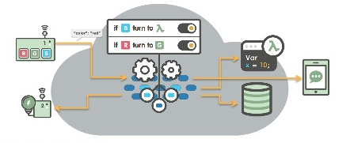
Data Processing
Transform, aggregate, enrich data and computing at high rate
Act on received information through rules processing
Trigger alert
Control automation (auto turn on or off air conditioner based on room temperature)
…

Slide 14
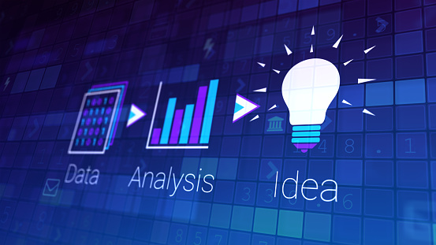
Data Analytics
Performing analytics on data obtained
Provides a rich source of information (data trends, prediction…)

Slide 15
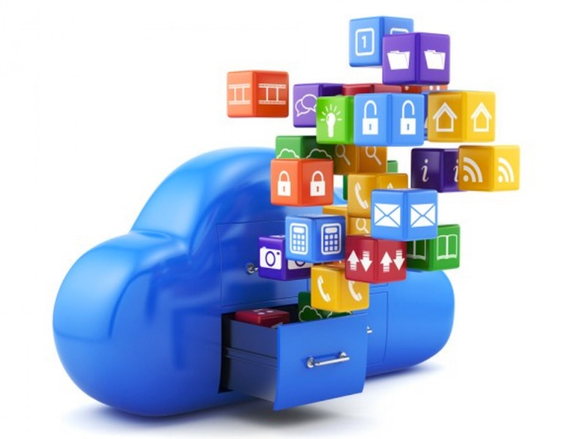
Data Storage
Data from the physical world comes in various shapes and sizes
Need to support range of storage solutions:
Unstructured blobs of data, such as images or video streams
Structured entity storage of devices or transactions
High-performance key-value databases for event and telemetry data

Slide 16
Visualization Application
Applications interacts with end users through UI
Visualize collected data through dashboard and reports
Support making decisions
Send information back to the devices
Diverse platform
Web
Mobile
Desktop app

Slide 17

Thank you!
Email
Website:
innovation@tma.com.vn
http://tma-innovation.center
Vietnam:
North America:
+84-2839-951-059
+1 844 224 4188
Australia:
Japan:
+61 414 734 277
+81 364 324 994
Email
Website:
innovation@tma.com.vn
http://tma-innovation.center

